Slide 1
Neural Network Modeler Powered by: Watson Studio
Naveen Panwar

Slide 2

Survey
https://goo.gl/mvGYHy

Slide 3

Outline
Neural Network Modeler(NNM)
Use of IBM Cloud Object Store (COS)
Design your deep learning model in NNM
Train your deep learning model
Download the trained model

Slide 4

Requirement
IBM Bluemix Cloud Account
http://console.bluemix.com/
IBM Watson Studio / Data Science Experience Account
http://datascience.ibm.com/
Tutorial Dataset and Wiki
https://github.com/rahular/ieee-dl-bootcamp

Slide 5

Hands-on Session

Slide 6

Steps
Create cloud object store service at IBM cloud dashboard
Upload data to COS
Create deep learning project in Watson studio
Create new modeler flow
Design valid network in canvas
Publish the network for training
Create experiment to train the model
Training definition
View and monitor the logs
Download the trained model from result bucket of COS

Slide 7
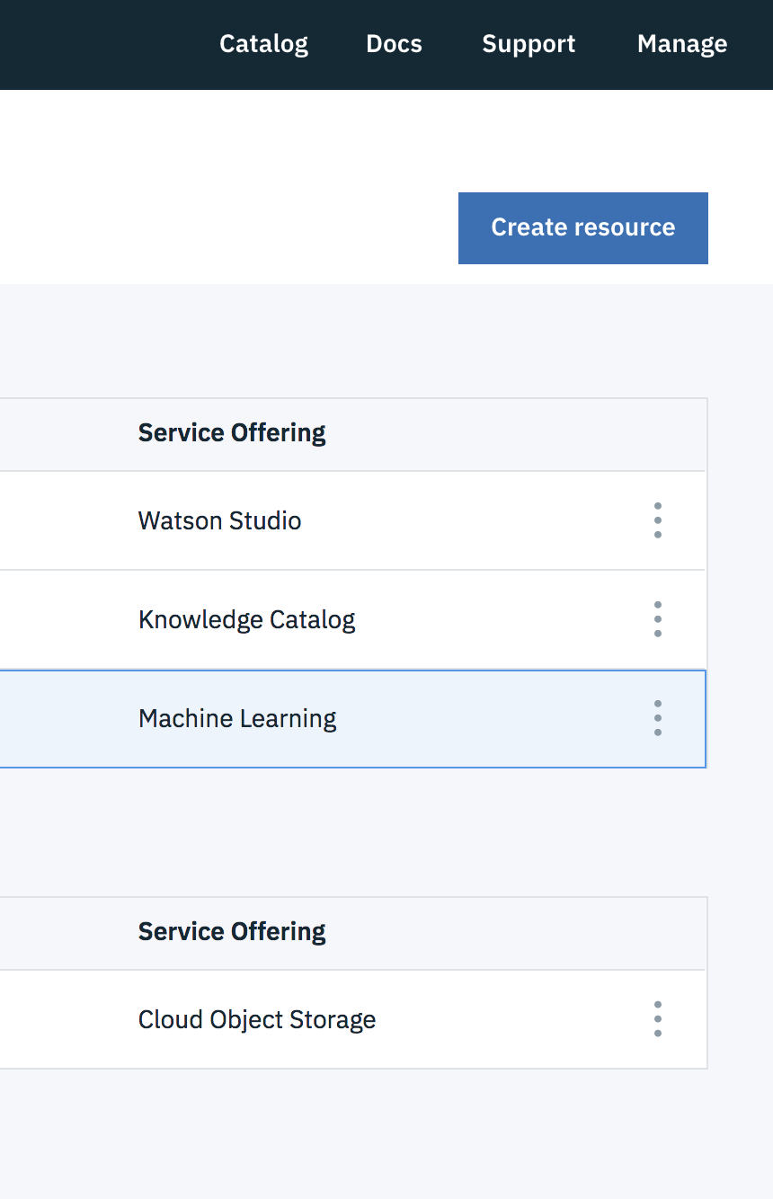
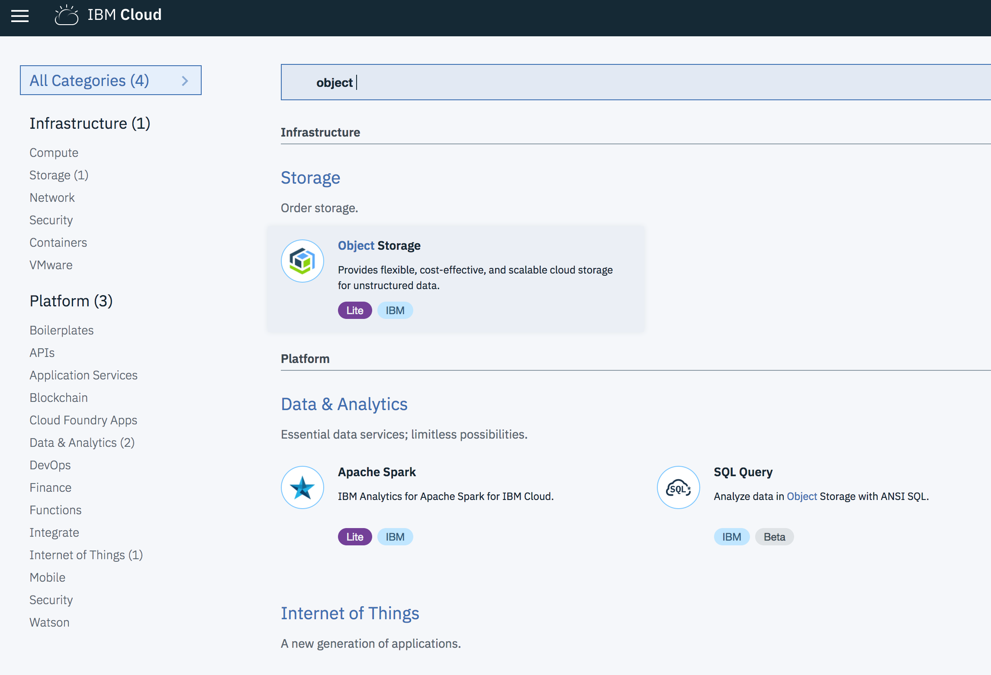

Cloud Object Storage

Slide 8
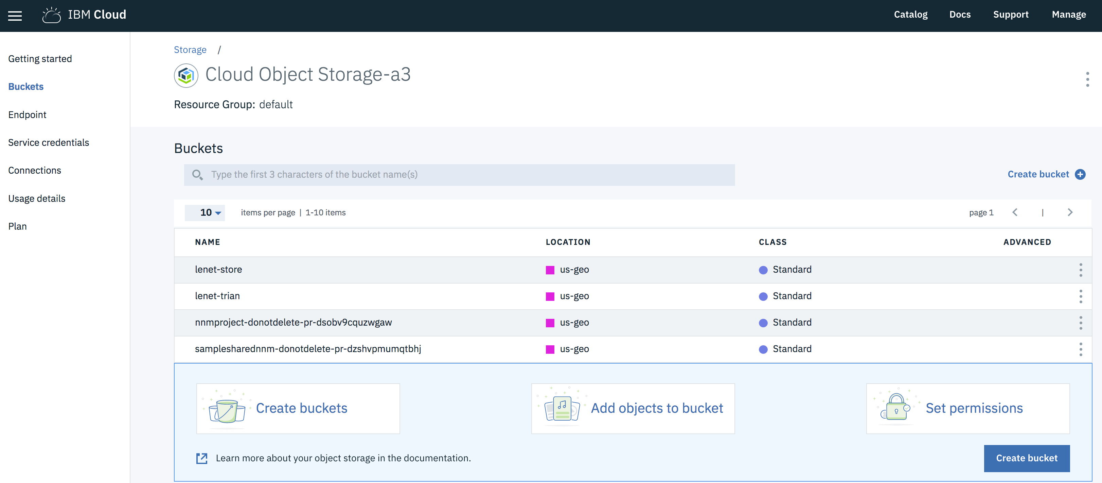
Upload Data to Bucket

Slide 9
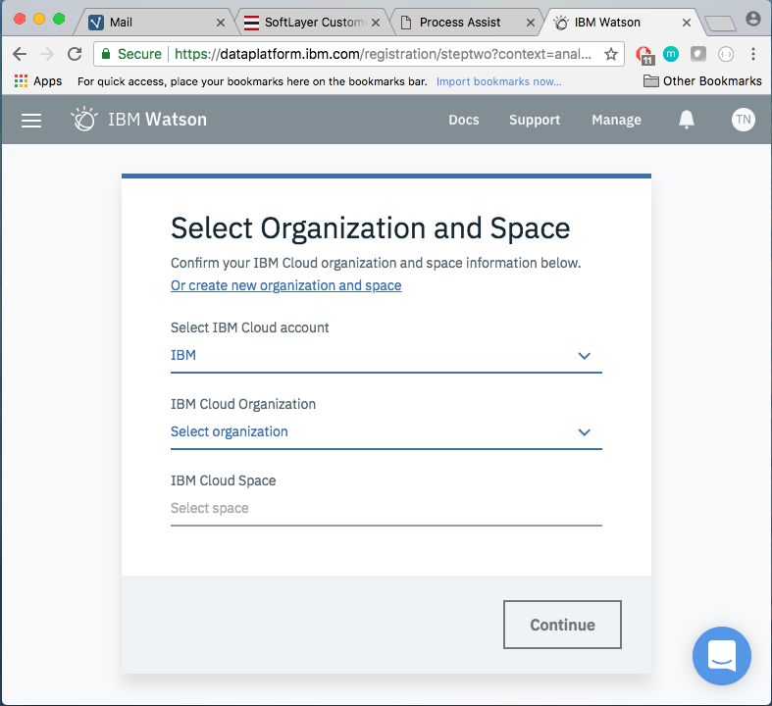
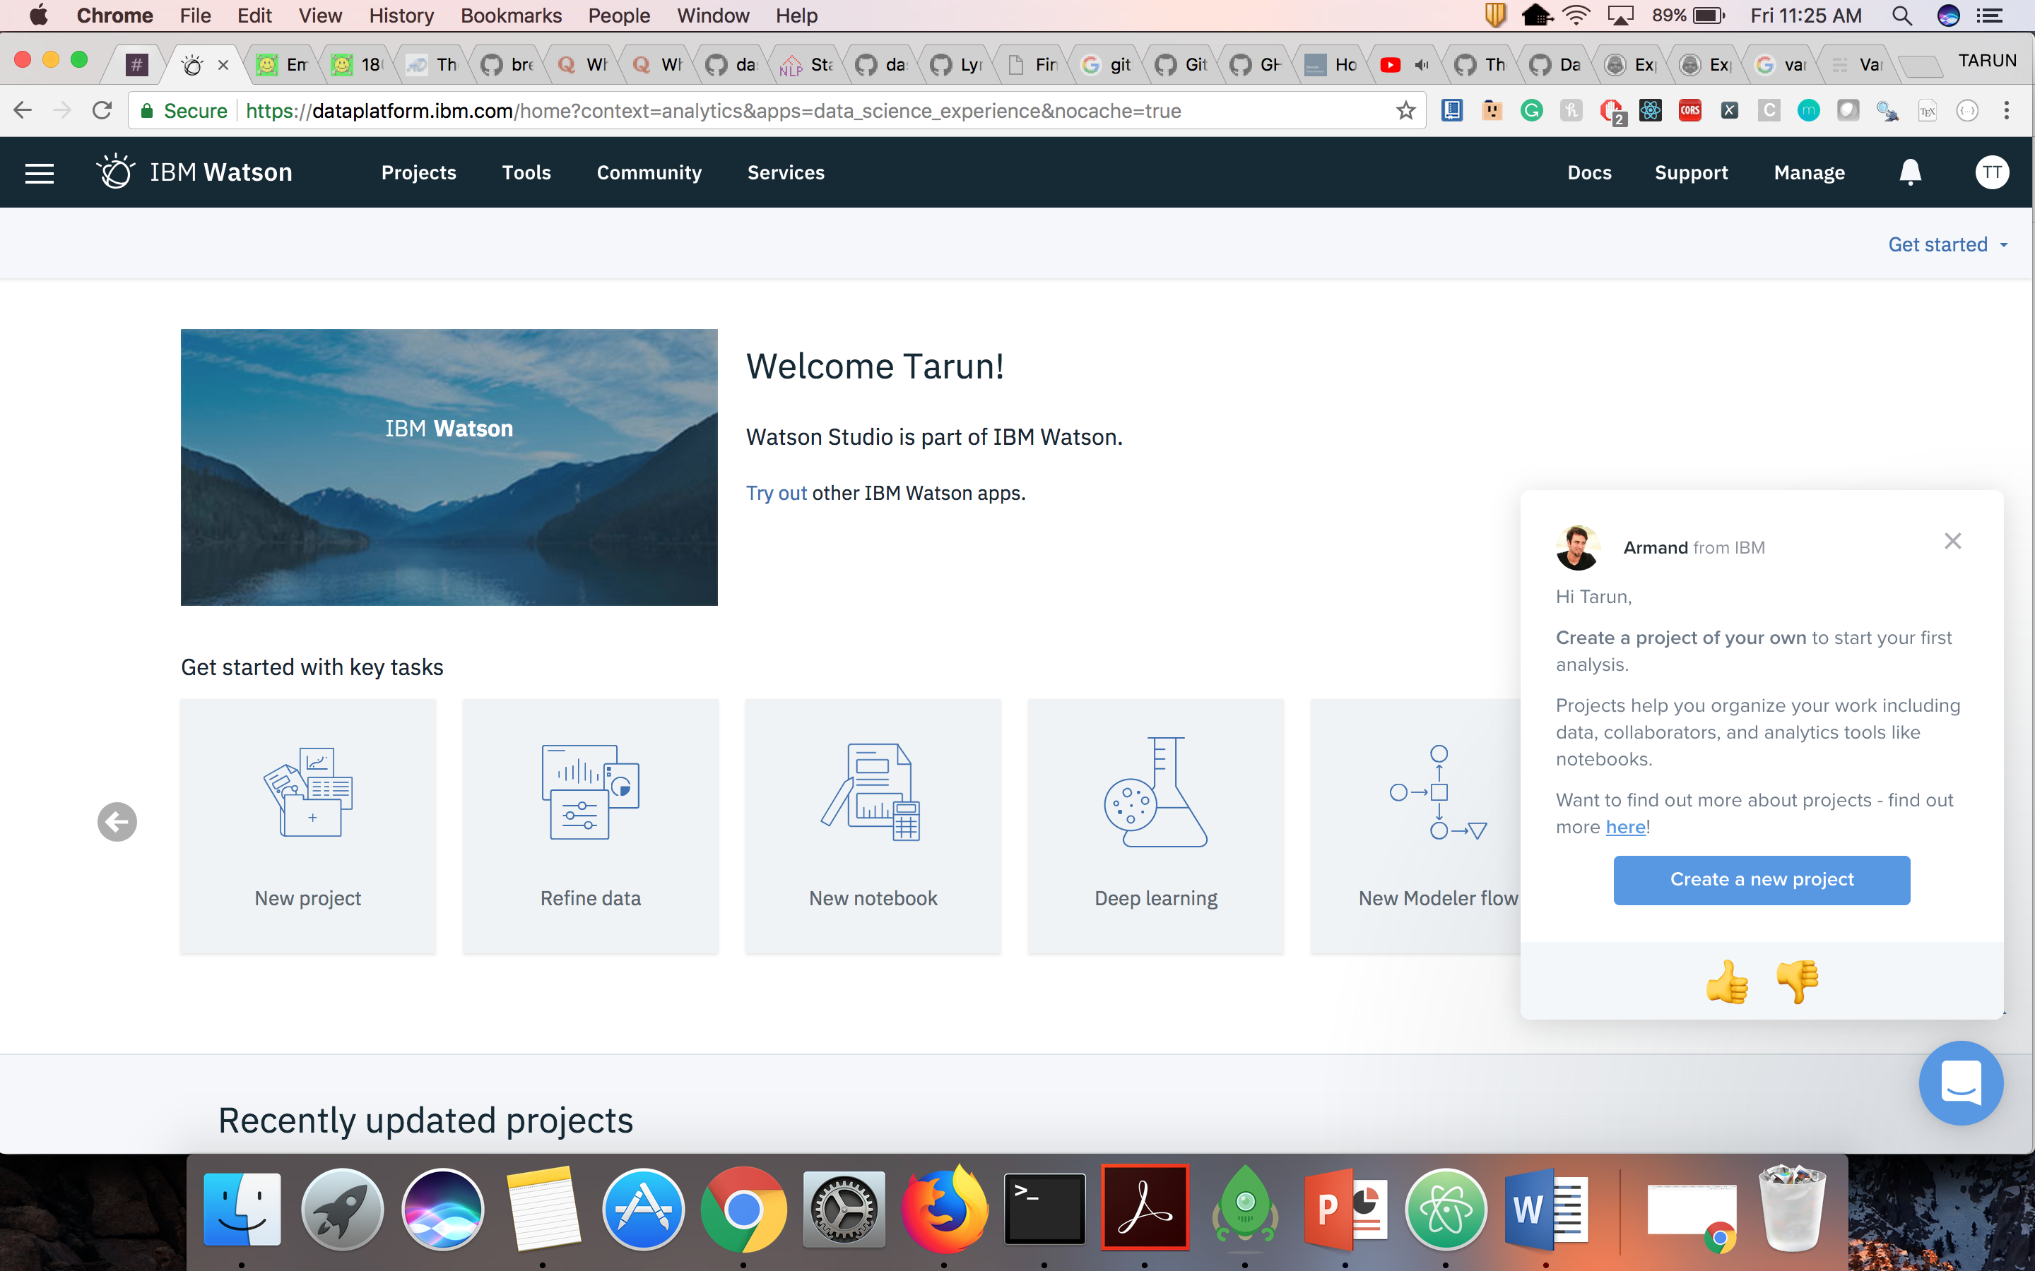
Watson Studio

Slide 10
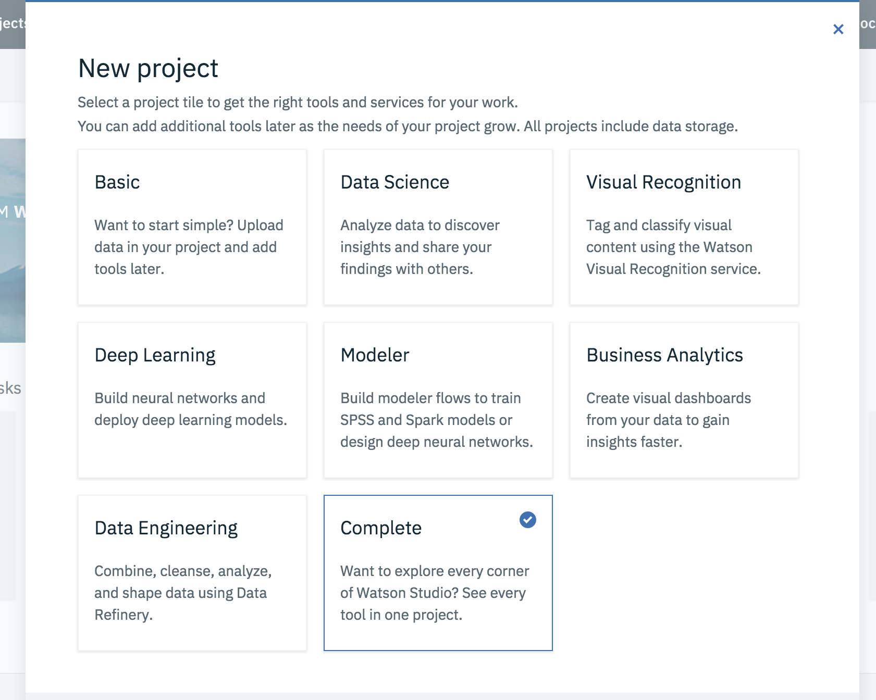
Deep Learning Project

Slide 11
Deep Learning Project

Slide 12
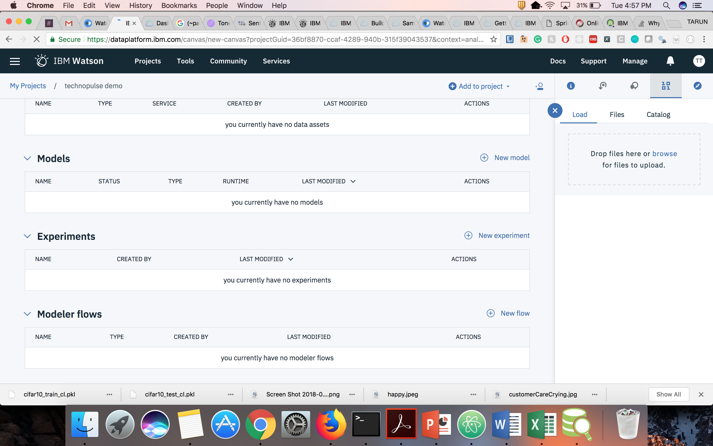
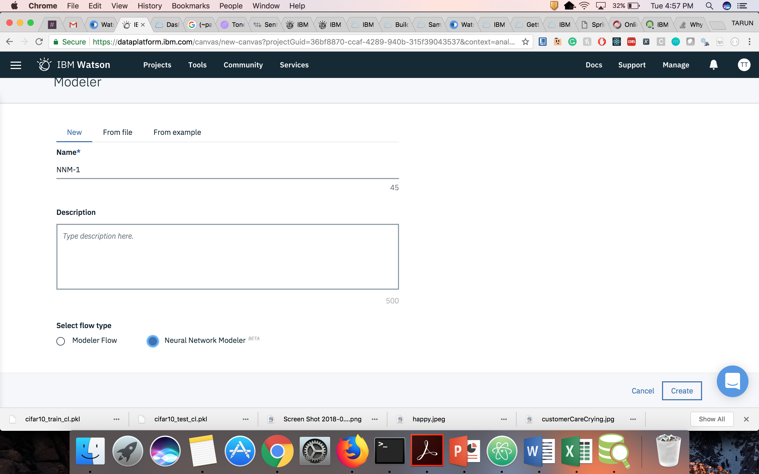
Modeler Flow

Slide 13
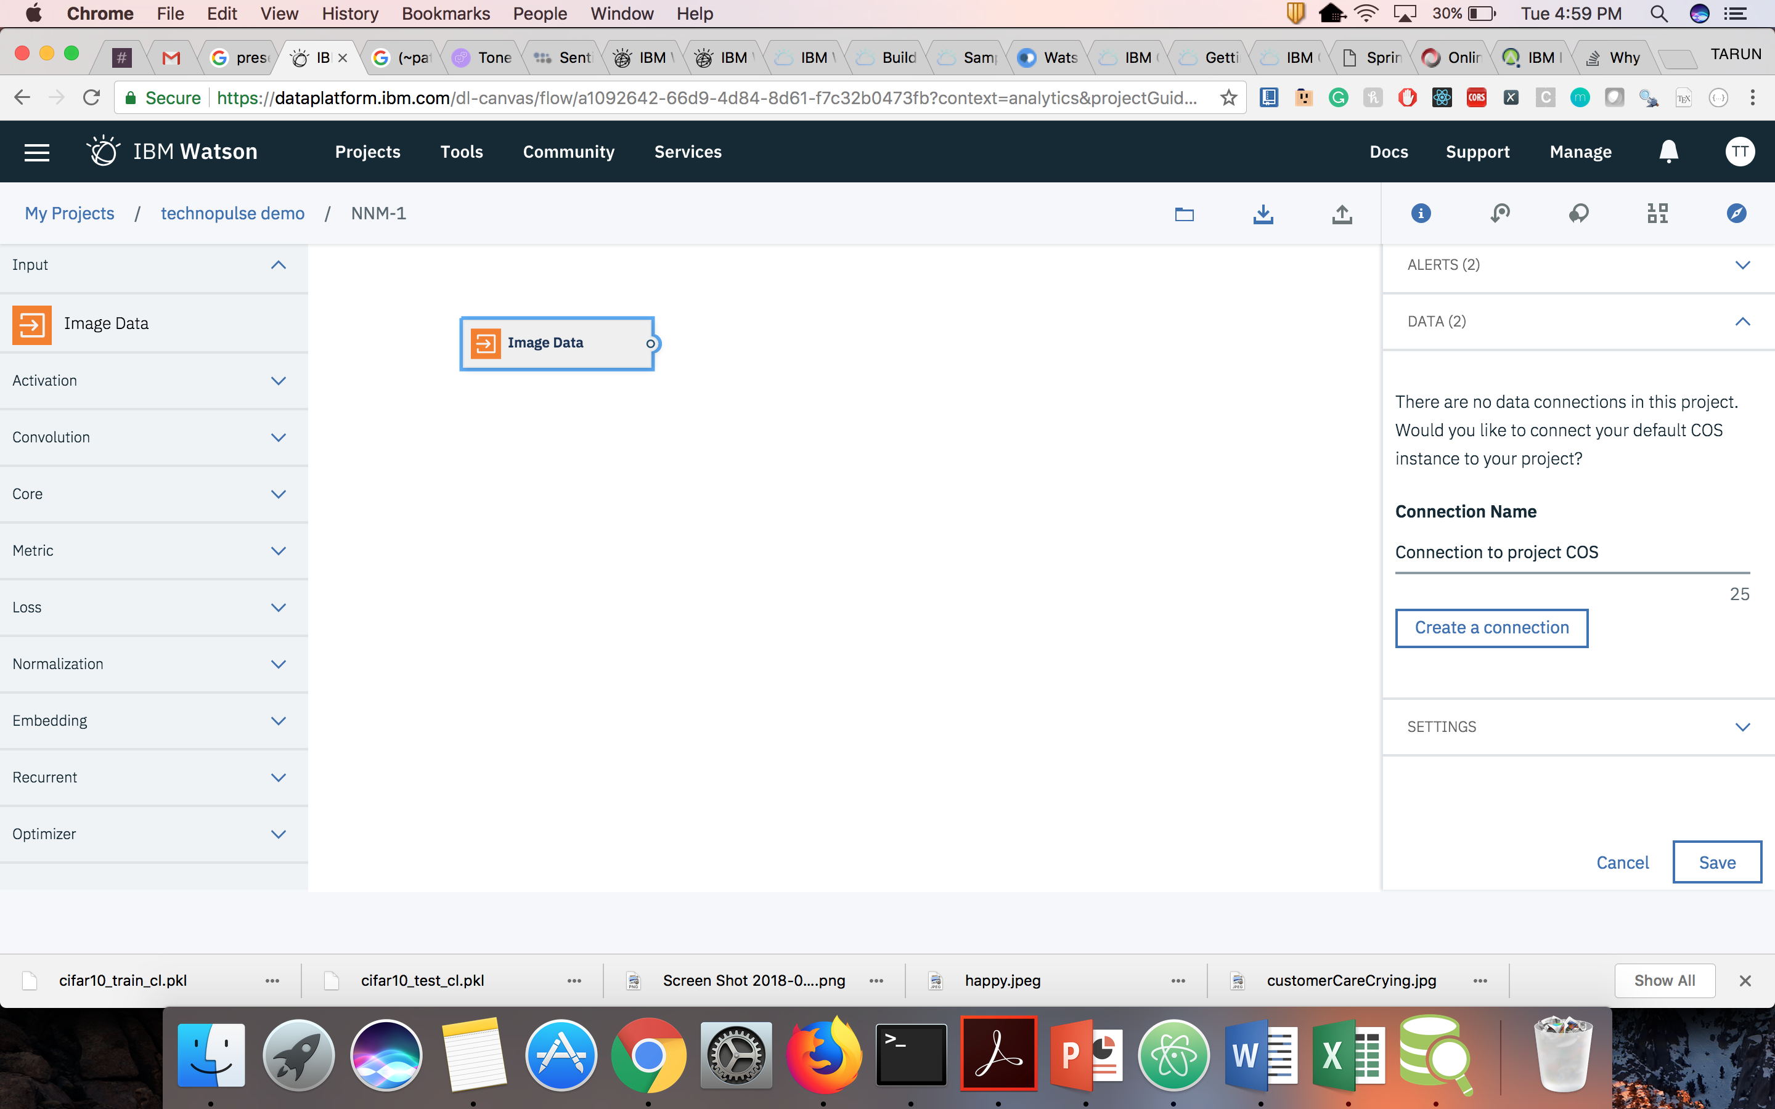
NNM Canvas

Slide 14
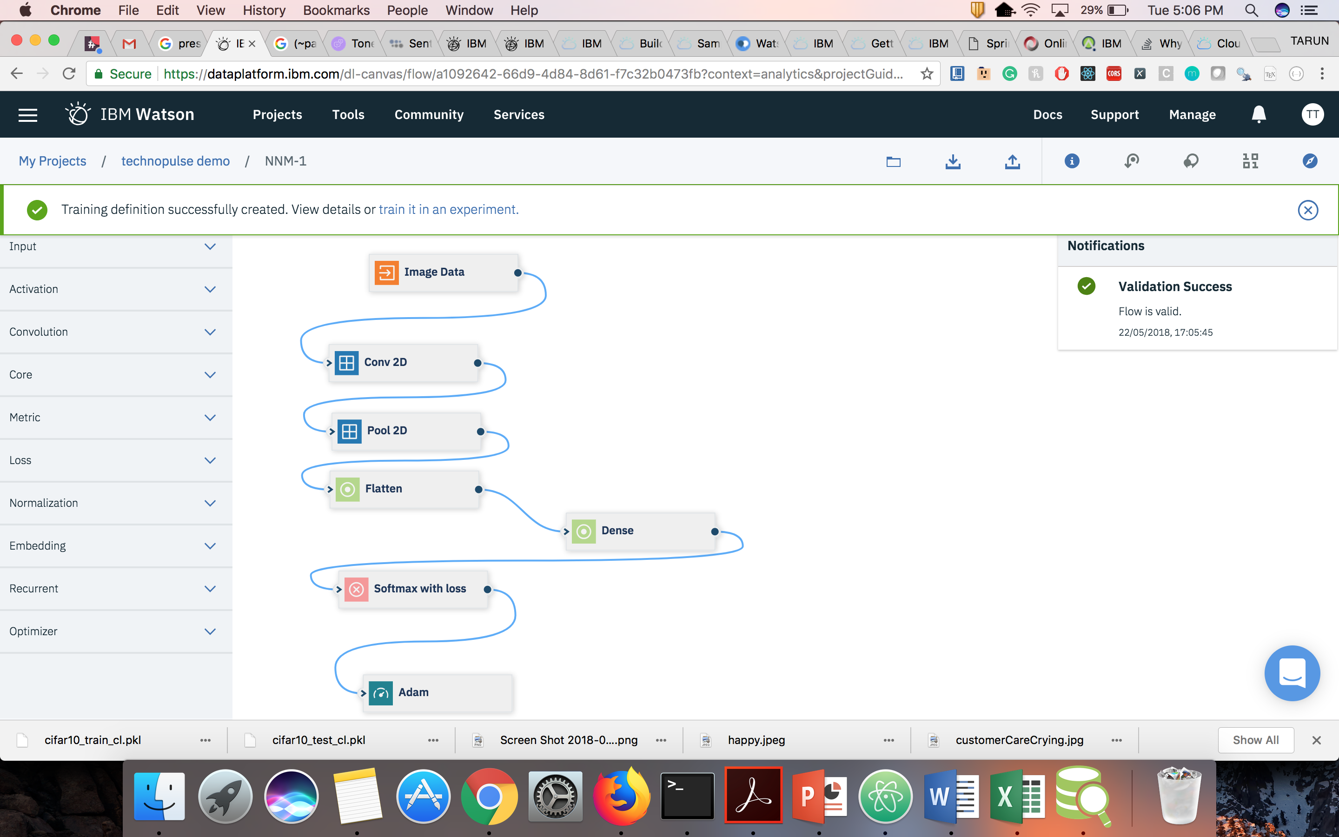
Publish Training

Slide 15
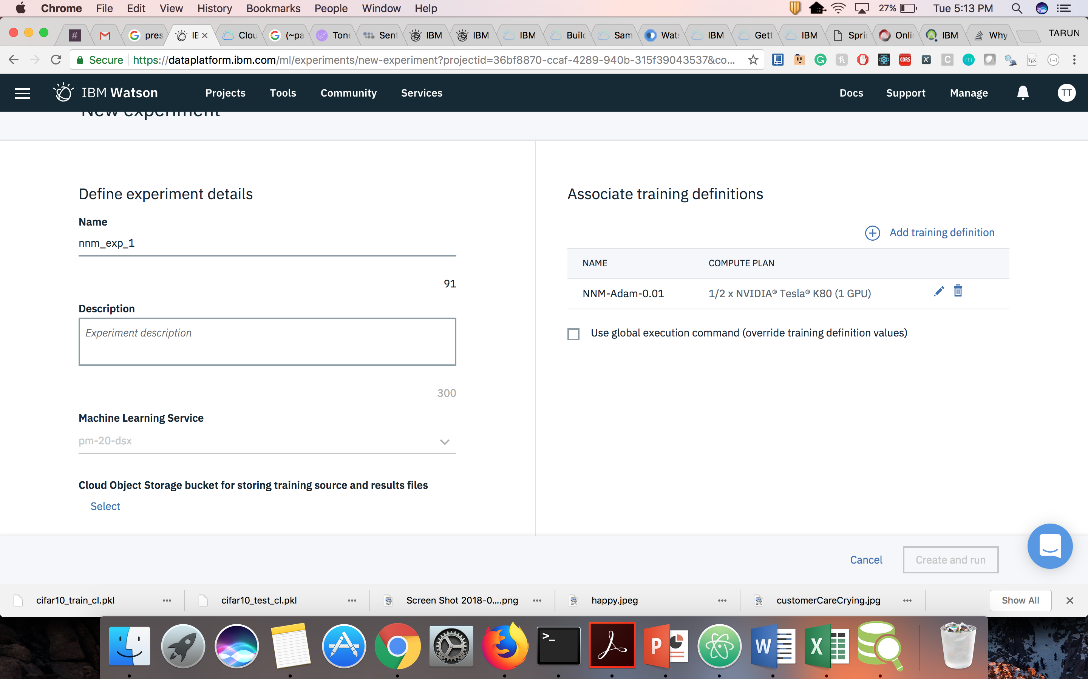
Create Experiment

Slide 16
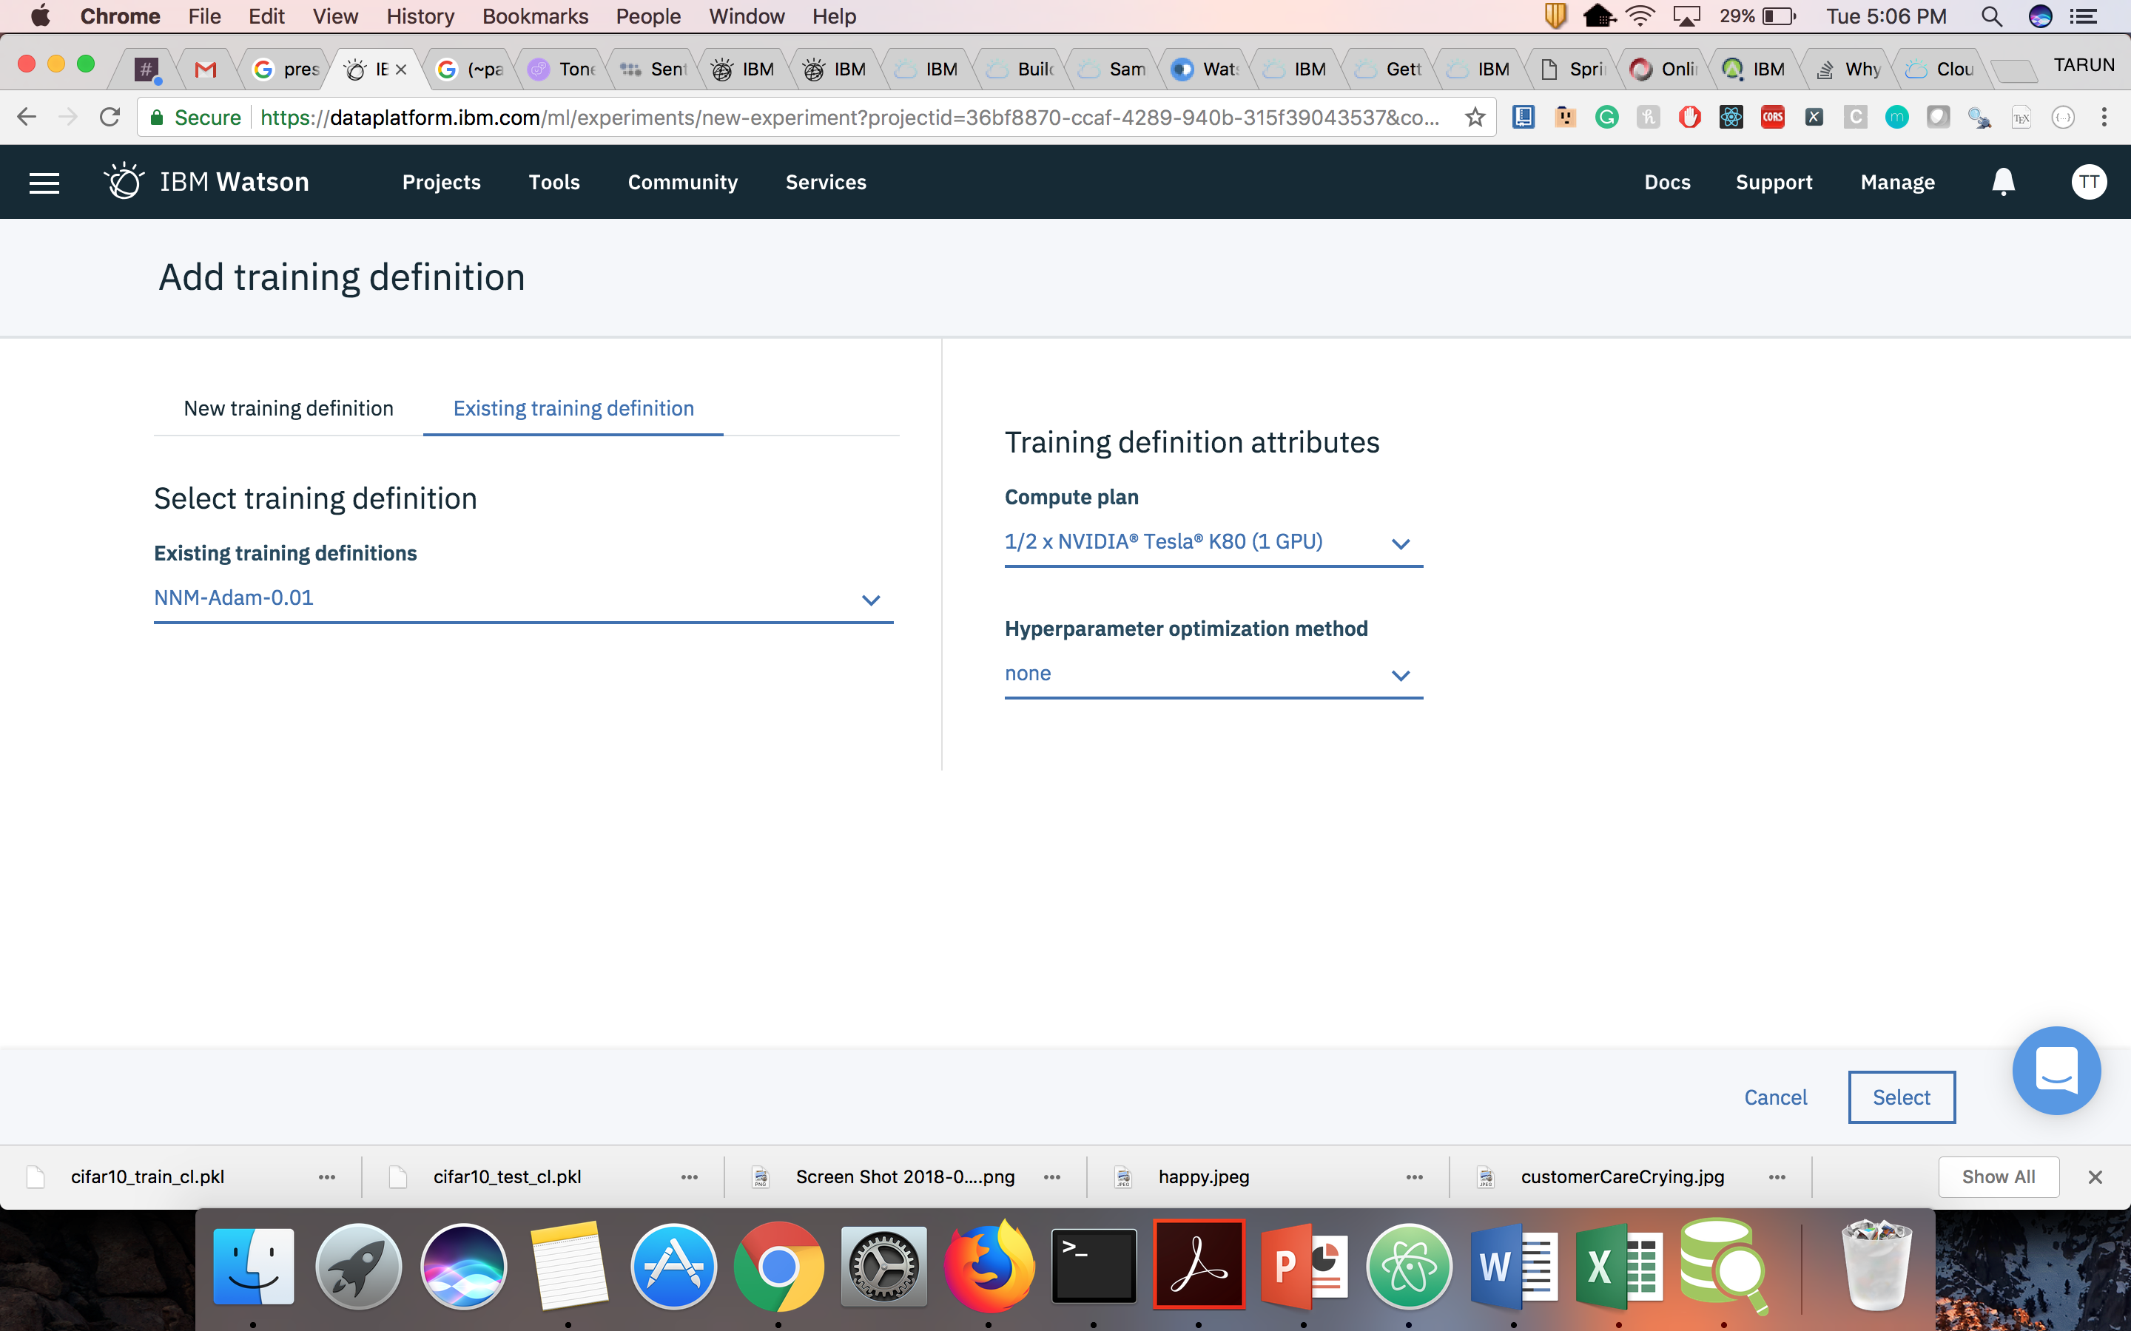
Add Training Definition

Slide 17
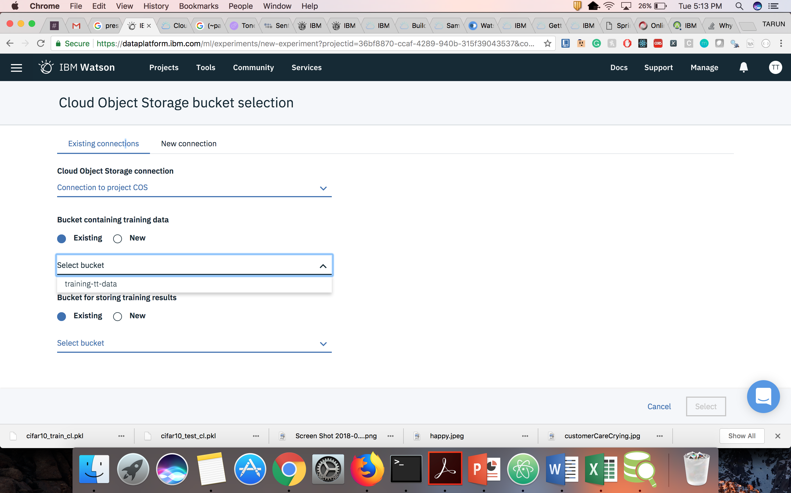
Add COS Details to Experiment

Slide 18
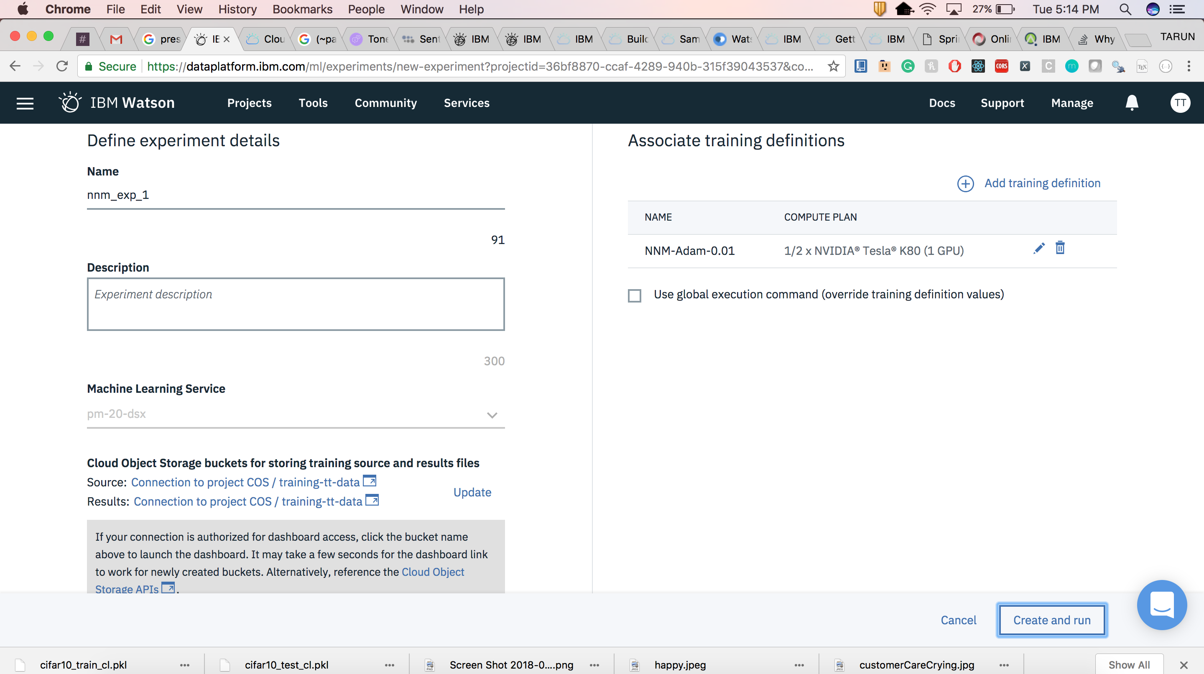
Create and Run

Slide 19
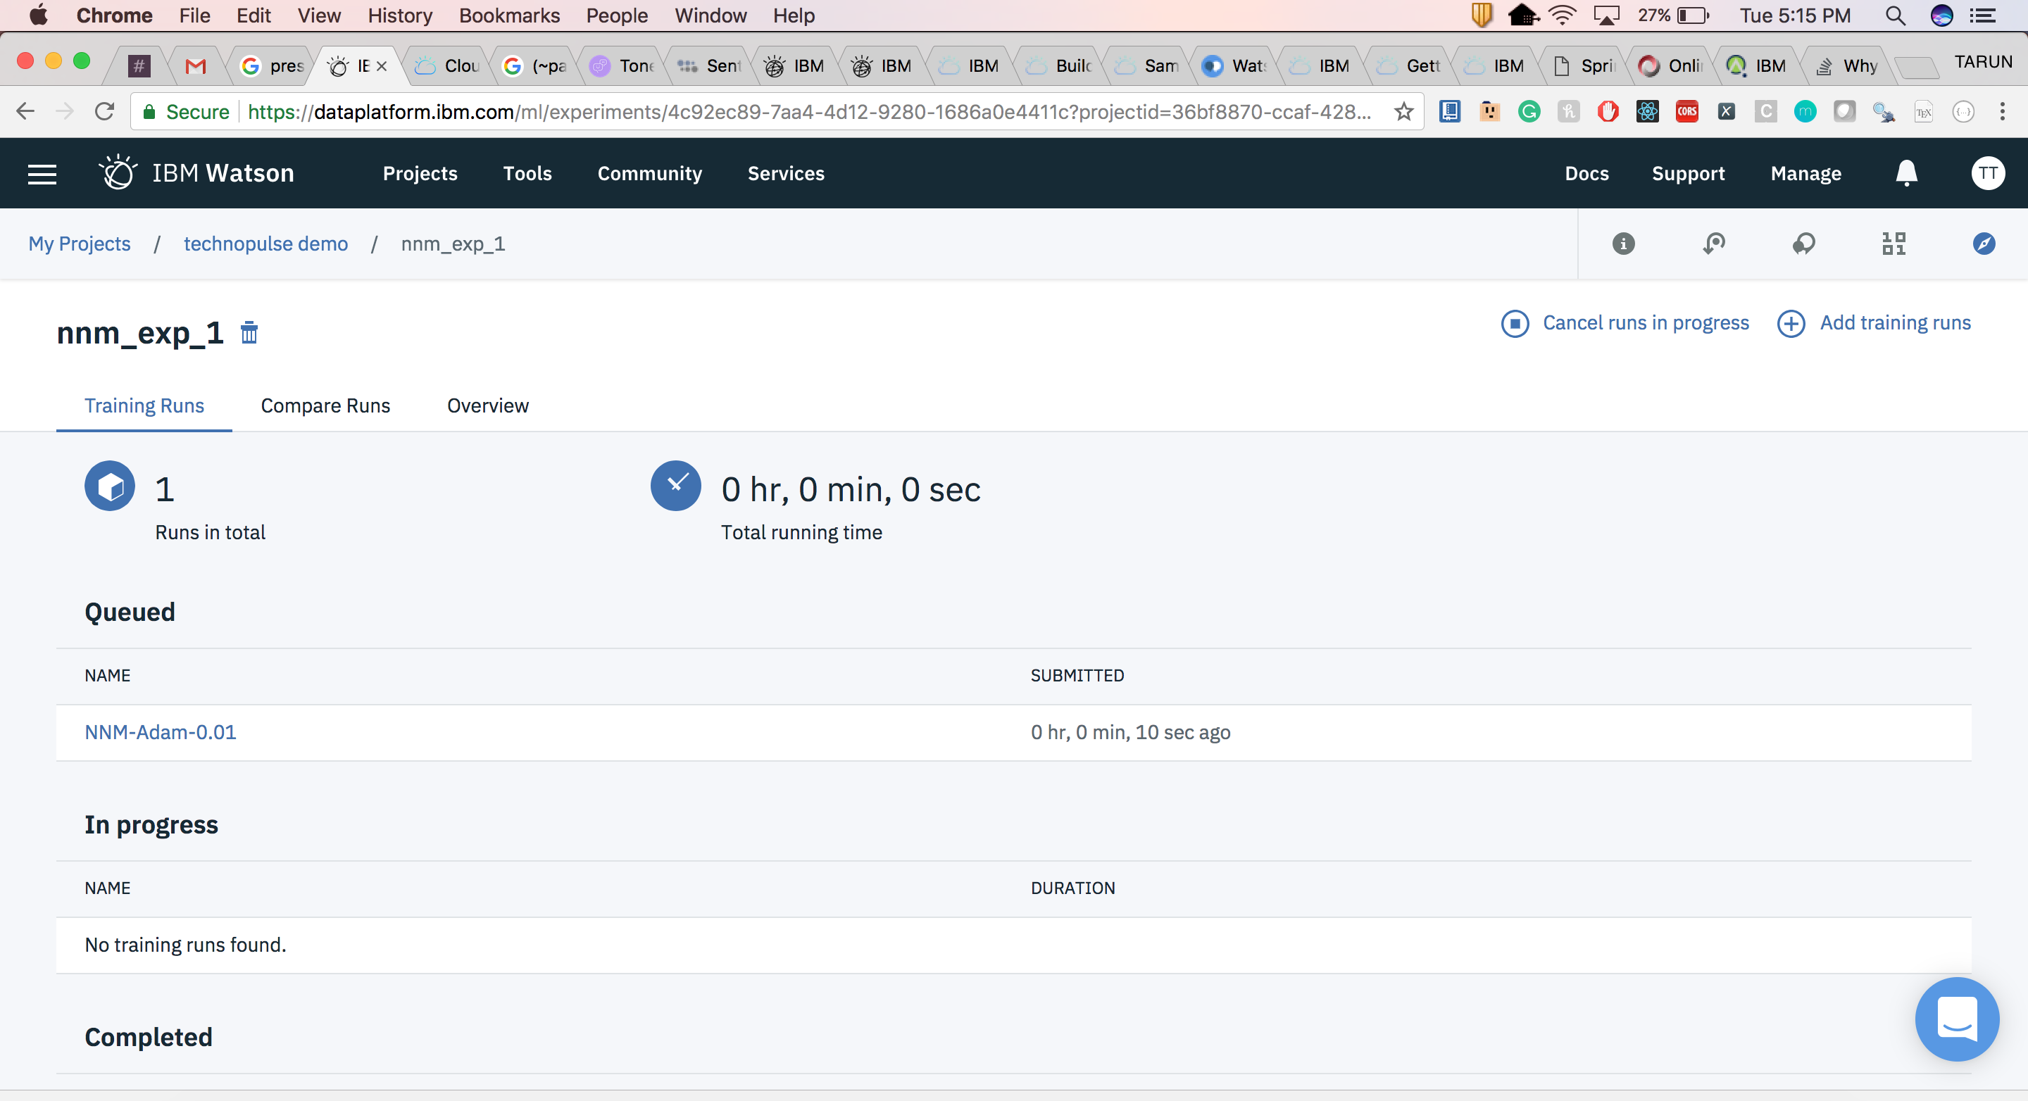
Experiments

Slide 20
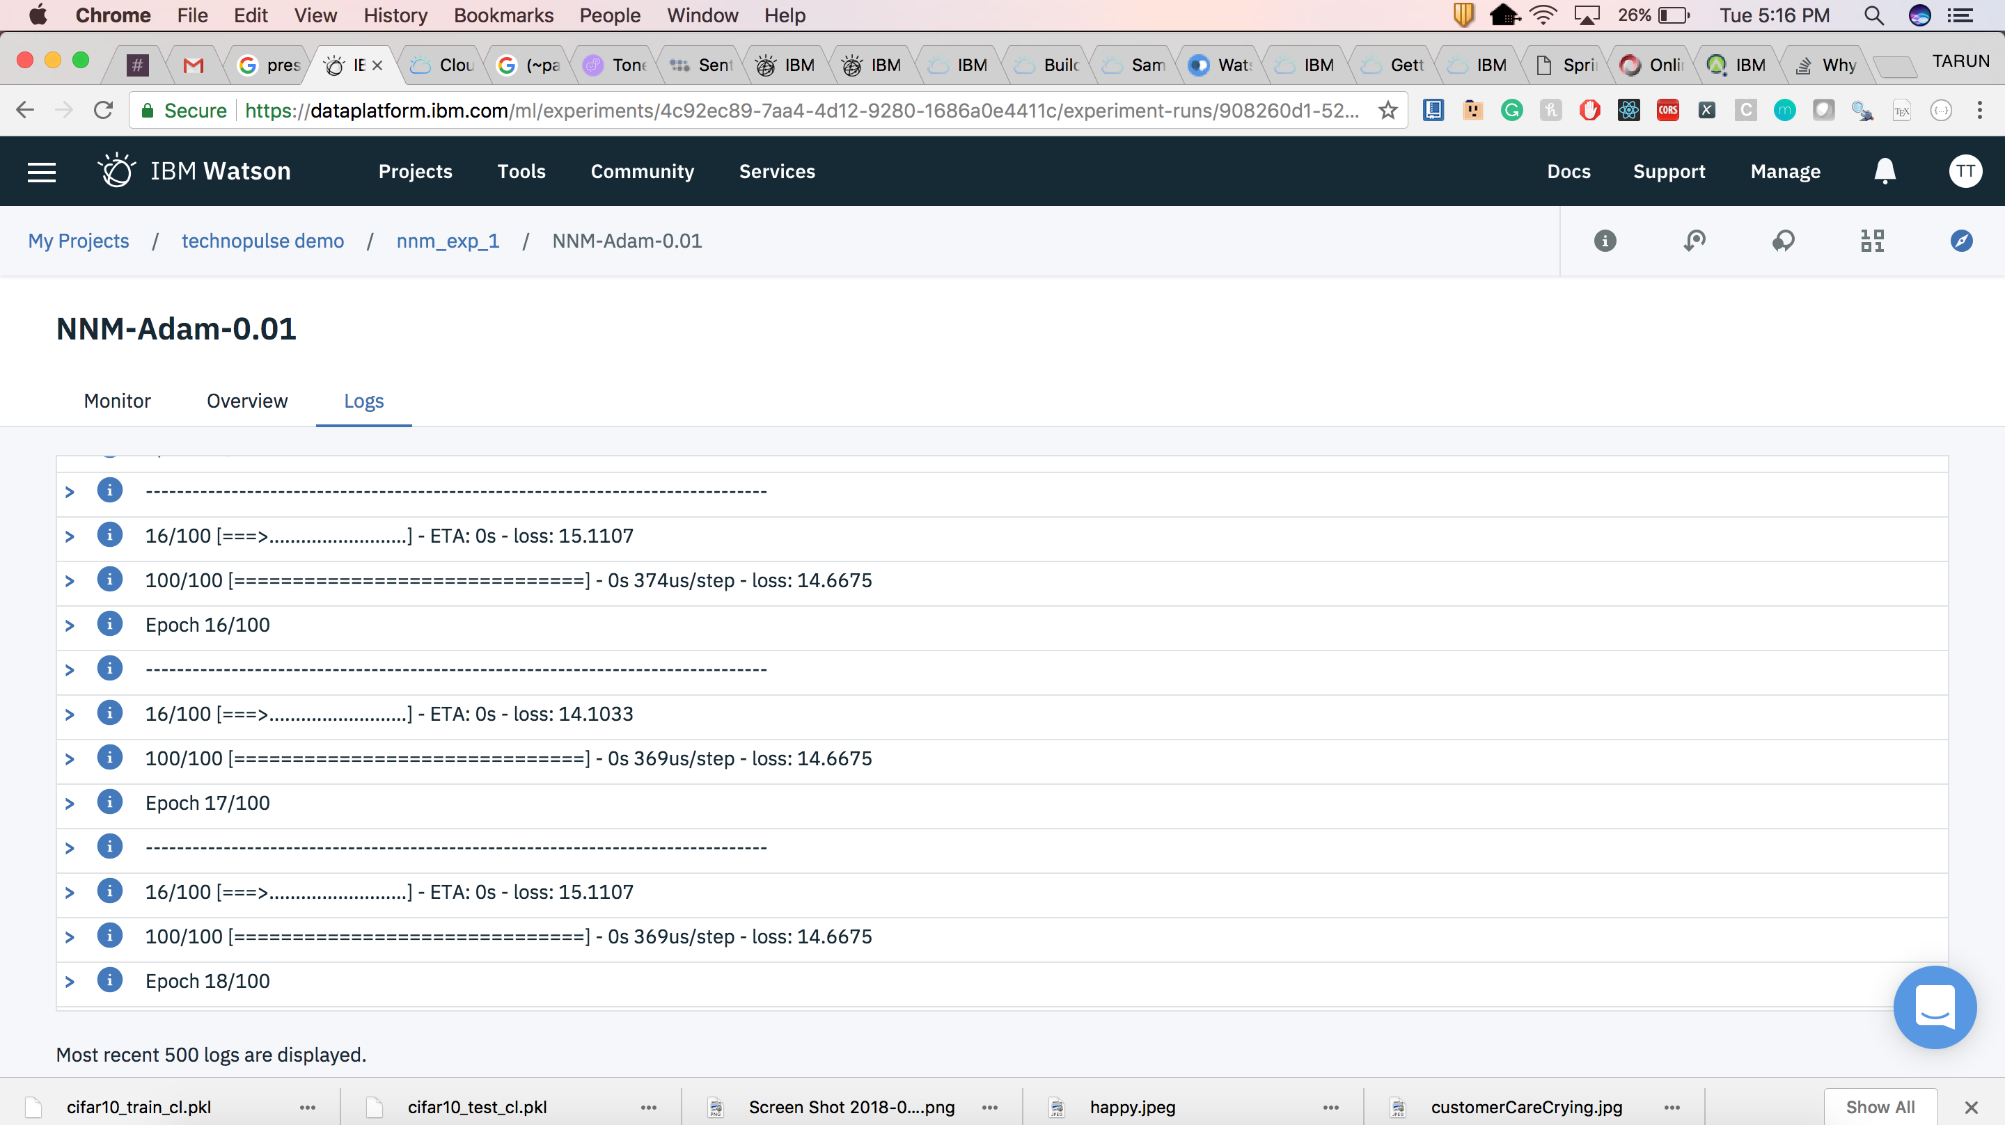
Logs

Slide 21
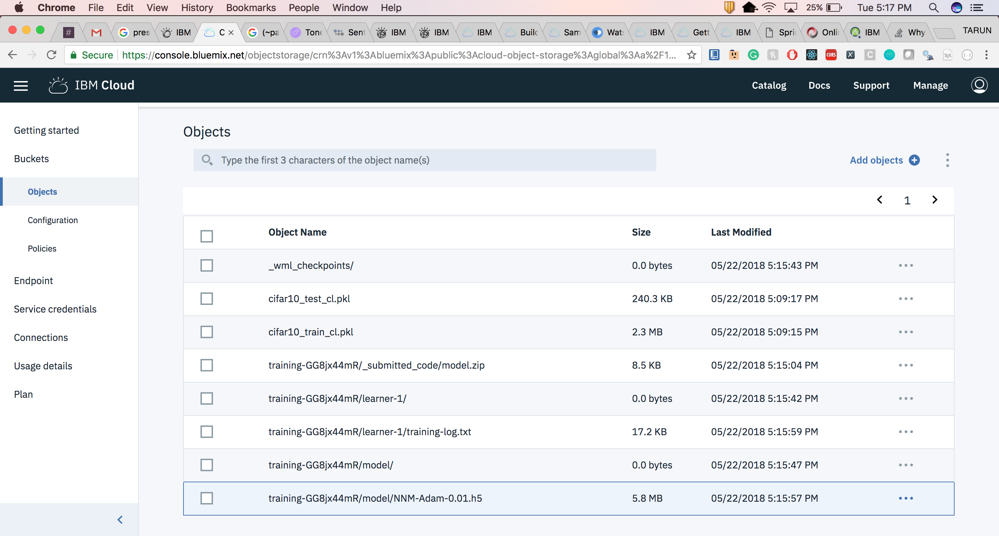
Trained Model

Slide 22
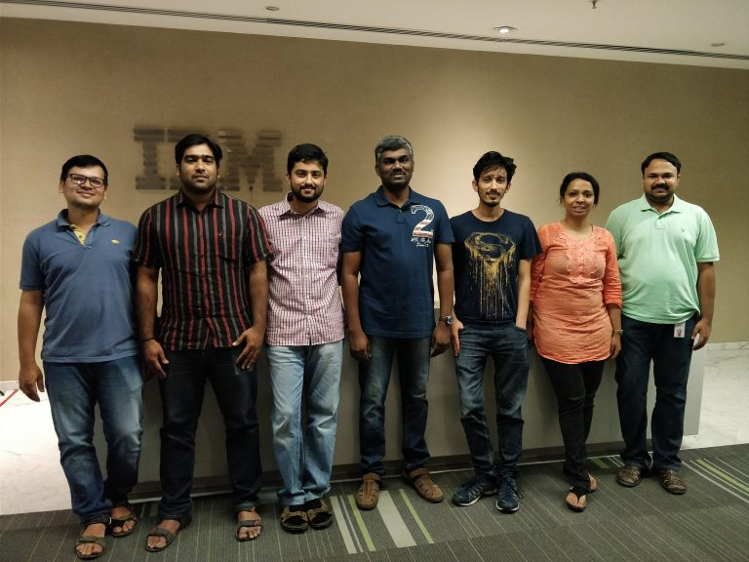
Team ☺

Slide 23
Special Thanks
For all screenshots :D
Tarun Tater
Tanmayee Narendra

Slide 24
Public Tutorials
Exploring Deep Learning and Neural Network Modeler with Watson Studio https://medium.com/ibm-watson/exploring-deep-learning-and-neural-network-modeler-with-watson-studio-ead35d21a438
Accelerate Your Deep Learning Experiments with IBM’s Neural Network Modeler https://medium.com/ibm-watson/accelerate-your-deep-learning-experiments-with-ibms-neural-network-modeler-dd0c92fba814
Deep Learning as a Service Now in IBM Watson Studio https://medium.com/ibm-watson/deep-learning-now-in-ibm-watson-studio-d8ba311e4ff1
Video Tutorial https://www.youtube.com/watch?v=EDQ0AWcUBnE

Slide 25

Questions ?
Slack Channel: #wml_dl_user

Slide 26
Thanks you ☺

